Slide 1
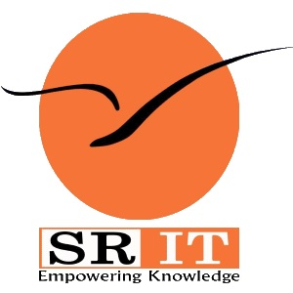
PROCESS MINING VIRTUAL INTERSHIP
by
AMADASANI NARENDRA BABU
Roll No. 224g1a3263
Department of Computer Science and Engineering (Data Science)
Srinivasa Ramanujan Institute of Technology
(Affiliated to JNTUA & Approved by AICTE) (Accredited by NAAC with ‘A’ Grade & Accredited by NBA (EEE, ECE & CSE)
Rotarypuram Village, B K Samudram Mandal, Ananthapuramu – 515701.
2024 - 2025

Slide 2

Contents
Course Objective
Introduction
Technology
Applications
Modules
Real Time applications
Learning outcomes
GitHub Link
Queries

Slide 3
Course Objective
Understand how to visualize and analyze business processes in real time.
Gain insights into process inefficiencies, bottlenecks, and areas for optimization.
Learn how to leverage Celonis for data-driven decision-making across various industries.
Learn to automatically discover process models and perform conformance checking.
Analyze process performance to identify inefficiencies and suggest improvements.

Slide 4
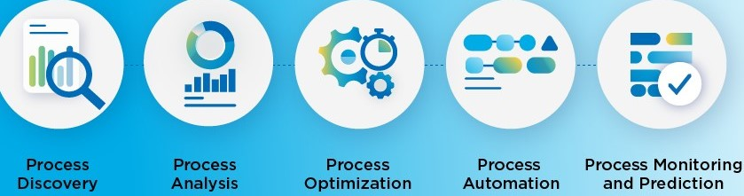
Introduction
Process mining is a technique that combines data science and process management to gain full visibility into how business processes are functioning by extracting and analyzing data from IT systems.
Key Techniques:
Process Discovery:Generates visual models of business processes from event logs to illustrate how processes are actually executed.
Process Analysis:Process analysis involves examining and understanding the various steps, inputs, and outputs of a business process to identify inefficiencies, bottlenecks, and areas for improvement.
Process Optimization: Process optimization refers to the practice of improving a business process to enhance efficiency, reduce costs, and increase overall effectiveness through data-driven strategies.

Slide 5
Introduction
Data-Driven Decision Making:Process mining provides insights from real data, leading to more informed and accurate decisions.
Process Transparency and Visualization:It visualizes workflows, making inefficiencies and deviations easy to spot.
Scalability: Easily applies to various industries such as finance, healthcare, and manufacturing, allowing businesses to continuously improve and adapt.
Shorter Time to Value:It delivers quick, actionable insights, allowing for faster process improvements.
Integration with AI and Automation:Combining AI with process mining enhances automation and proactive problem-solving.

Slide 6
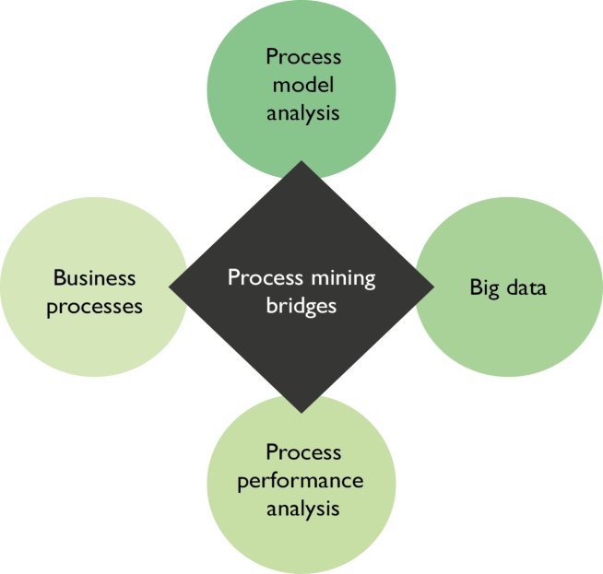
Technology
Key Technologies in Process Mining:
Process Discovery:Techniques used to automatically generate process models from event log data, allowing organizations to visualize actual workflows.
Big Data:Capabilities to handle and analyze large-scale event logs generated by various IT systems, allowing for in-depth process analysis.
Visualization
Dashboards: Tools like Power BI and Tableau deliver real-time insights through interactive visualizations, enabling users to monitor process performance effectively.
Data Integration
Big Data: Handle large-scale event logs
Cloud Platforms: Store and process data (AWS, Google Cloud)
Process Mining Tools
ProM (Open-source), Celonis (Commercial)

Slide 7
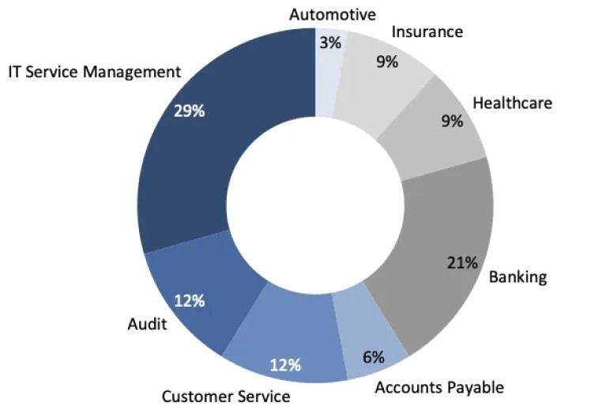
Applications
Finance:
Automating invoice processing and optimizing cash flow.
Manufacturing:
Streamlining production lines and minimizing delays.
Healthcare:
Improving patient flow and resource allocation.
Retail:
Optimizing supply chain and inventory management.
Healthcare:
Optimizes the care treatment by releasing the delay in the waiting time by performing process analysis on patient care.

Slide 8
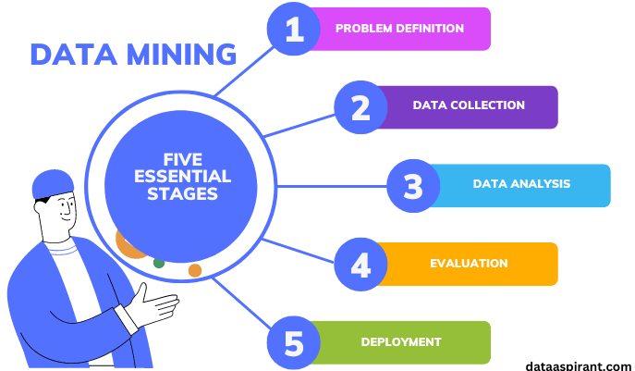
Modules
Modules of Process Mining
Data Collection
Gather event log data from various IT systems for comprehensive process coverage.
Data Analysis
Analyze the data to identify patterns, trends, and anomalies in the processes.
Evaluation
Assess process performance using key performance indicators (KPIs) to
pinpoint areas for improvement.
Deployment
Implement identified improvements in real-world processes, ensuring
smooth integration.
Problem Definition
Define specific problems or inefficiencies to guide the analysis and solution
development.

Slide 9
Real Time Applications
1.Retail Industry: Monitoring stock levels, delivery times, and sales processes to enhance customer satisfaction.
2.Financial Services: Managing compliance, risk, and fraud detection in banking and insurance.
3.Manufacturing: Streamlining workflows to minimize production delays and reduce material wastage.
4.Telecommunications: Optimizing service delivery, billing systems, and customer support processes.
5.Agile Decision-Making:
Allows organizations to adapt their processes rapidly based on real-time insights, ensuring they remain competitive and responsive to changes
Predictive Analytics: Predict bottlenecks before they occur in real-time.
Process Automation: Automate mundane tasks like order processing or invoice approvals.

Slide 10
Learning Outcomes
Understand the core concepts of process mining and how to implement it using Celonis.
Gain hands-on experience in extracting, preparing, and analyzing data for process improvement.
Develop skills in identifying process inefficiencies and implementing AI-driven optimizations.
Learn how to apply process mining to real-world scenarios and drive business outcomes.
Gain a solid understanding of process mining principles and how they apply to real-world scenarios.
Be able to interpret process mining models and derive actionable insights.
Develop the ability to use Celonis to identify inefficiencies and opportunities for improvement in business processes.
Learn how to apply automation and AI to optimize processes.
Enhance their analytical and problem-solving skills with hands-on experience using Celonis tools.

Slide 11
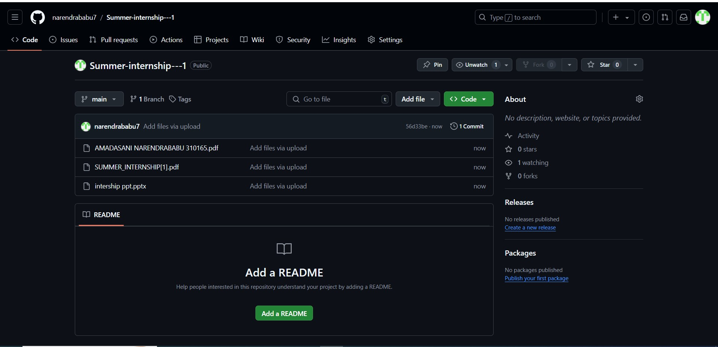
Git Hub Dashboard

Slide 12
Any Queries?

Slide 13
Thank You!!!

